Slide 1

Khatra Adibasi Mahavidyalaya
Department of Mathematics
Normal Subgroup
Session : 2021-22
Programme : B.Sc. Math (Honours) 3rd sem
Paper : Group Theory I (C-6)
Date of Delivery : 15-12-22.
...Presented by
Madhab Kr Nandi

Slide 2
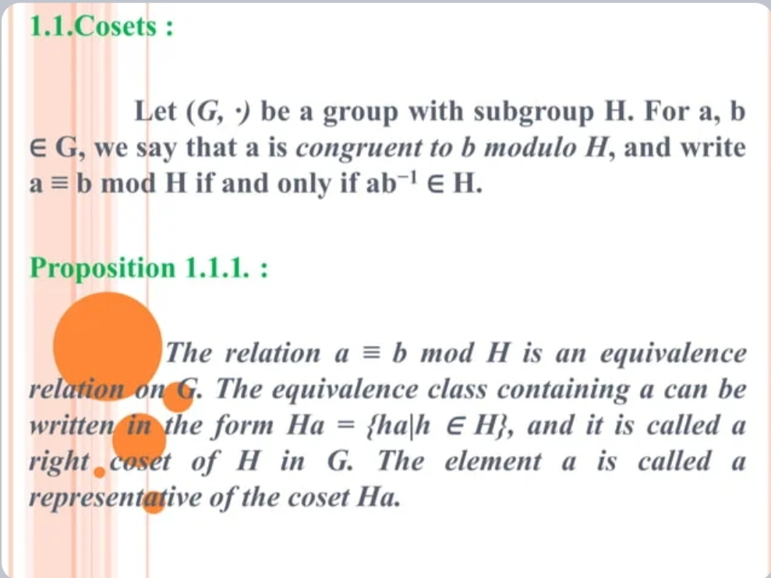

Slide 3
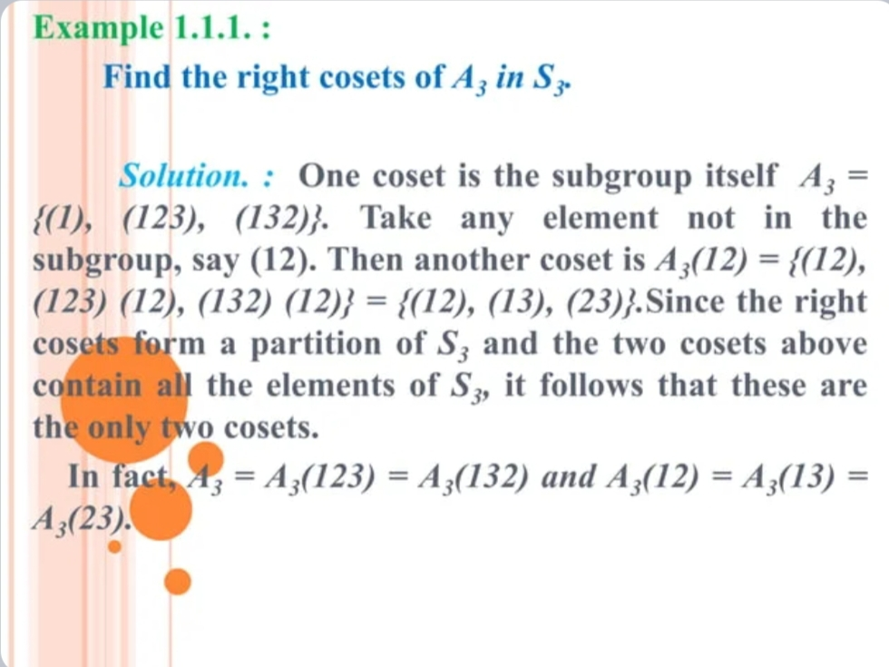

Slide 4
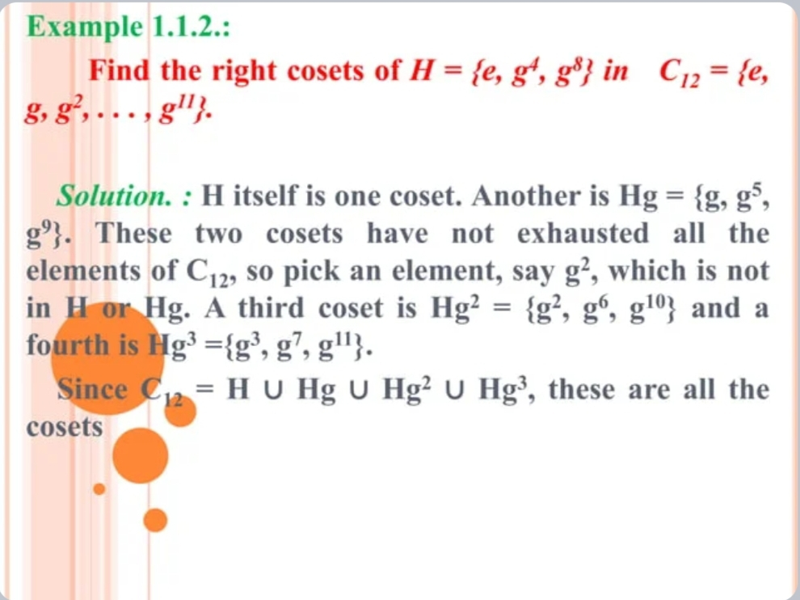

Slide 5
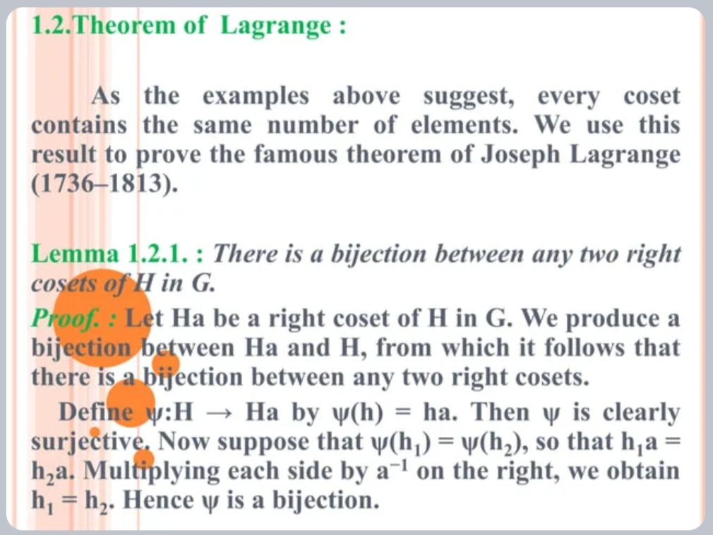

Slide 6
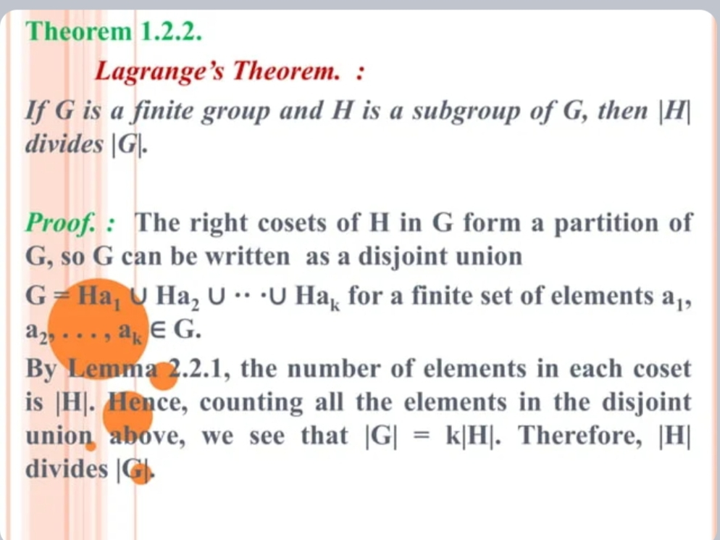

Slide 7
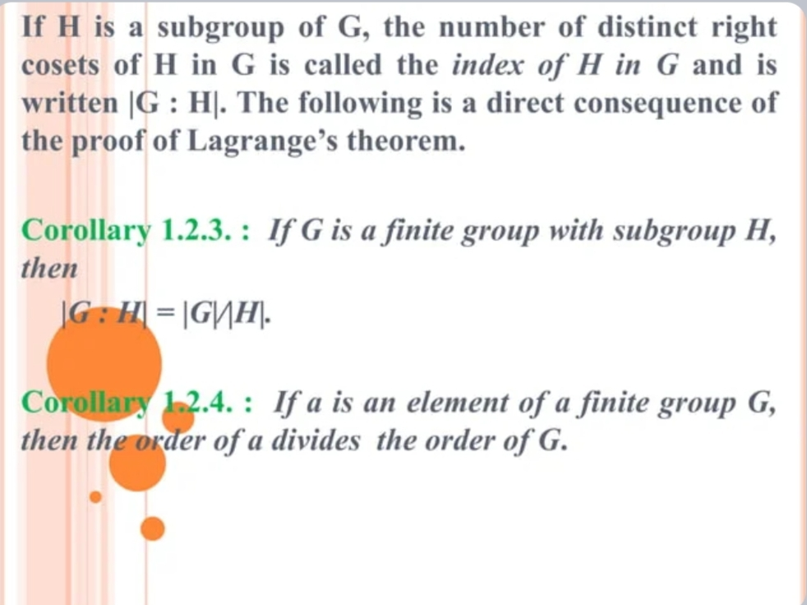

Slide 8
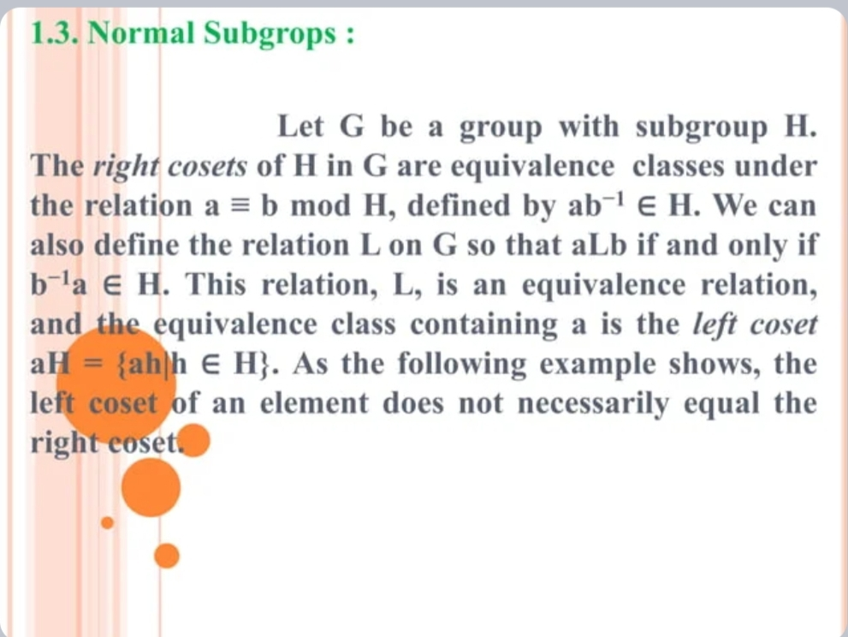

Slide 9
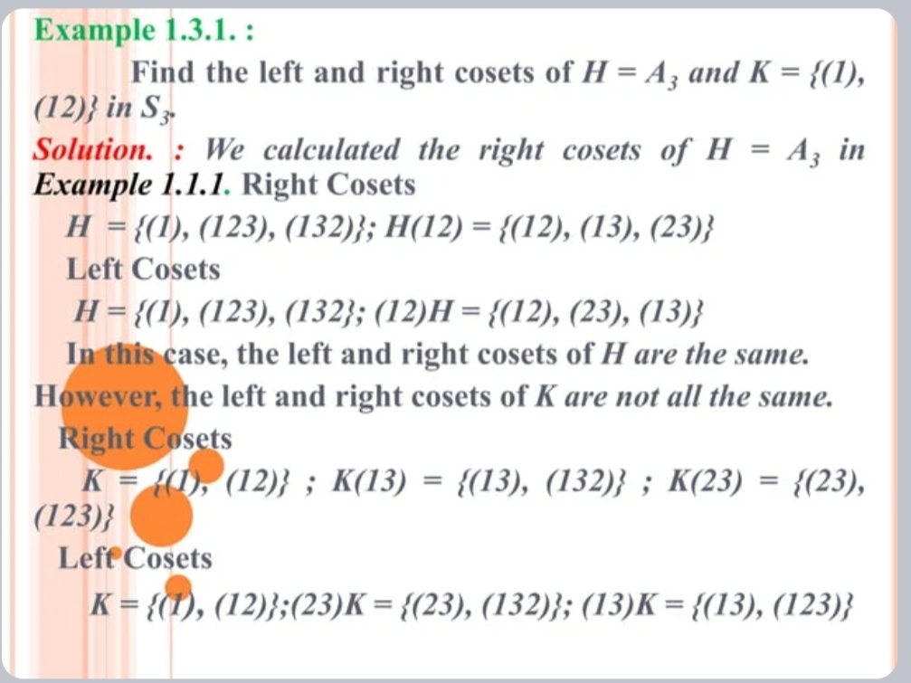

Slide 10
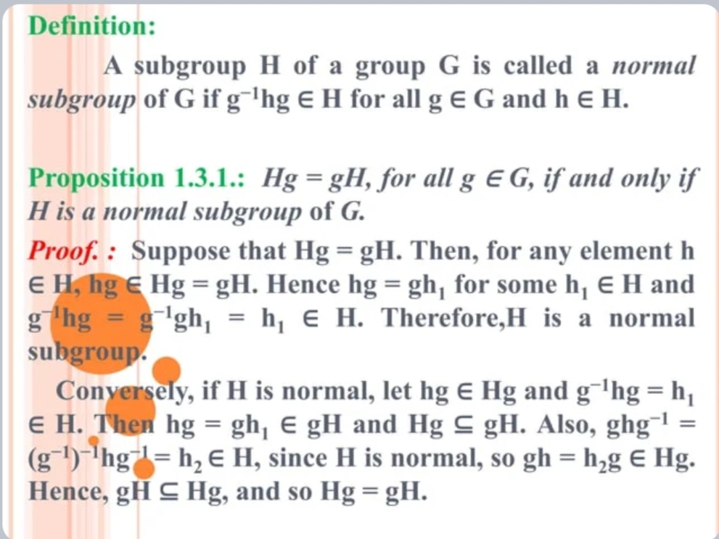

Slide 11
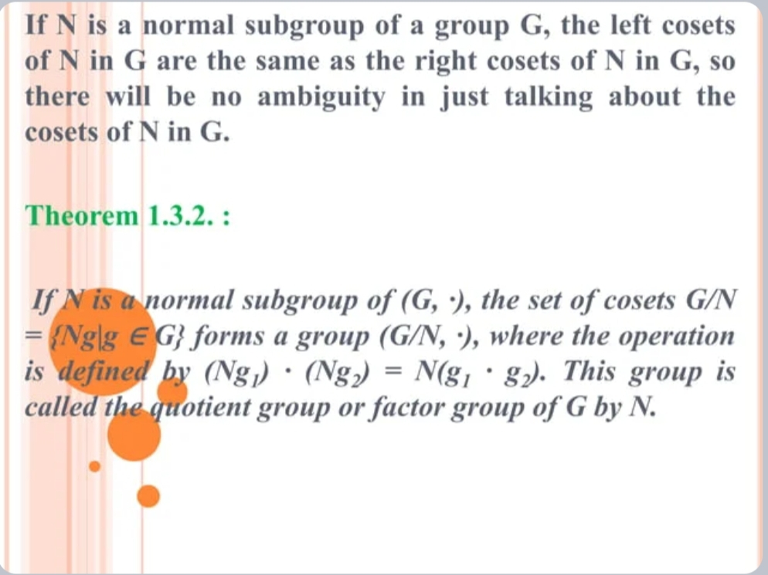

Slide 12
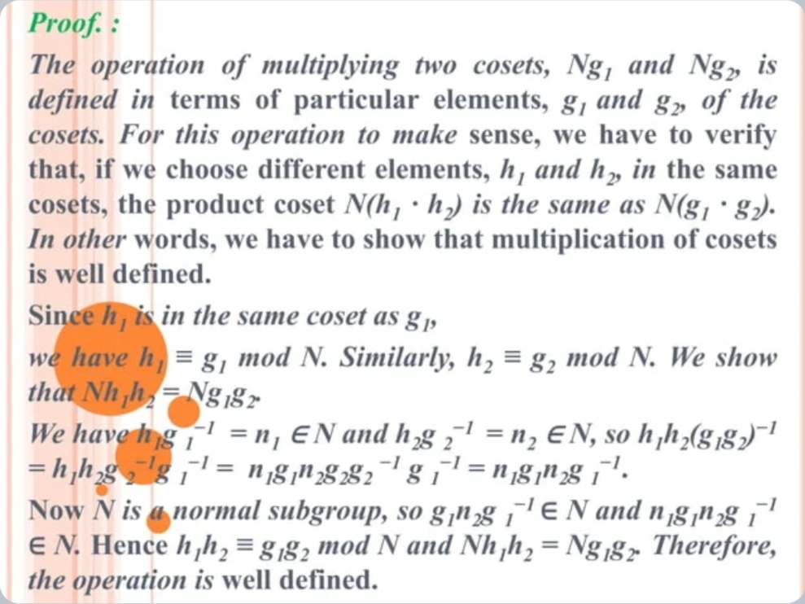

Slide 13
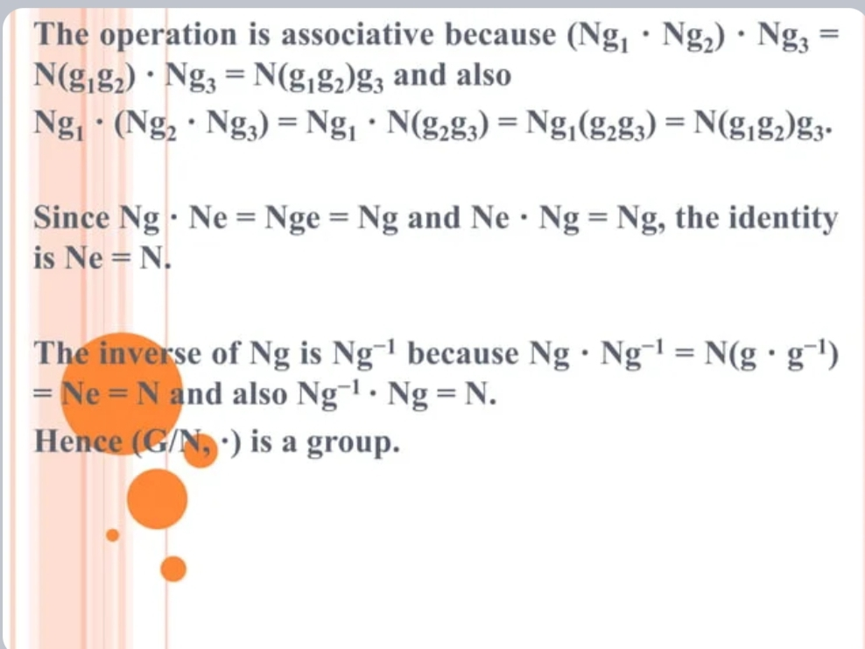

Slide 14
